Slide 1
Insert Presentation Title Here
For Small Businesses

Slide 2
Insert Presentation Title Here
For Small Businesses

Slide 3
Insert Presentation Title Here
For Small Businesses

Slide 4
Insert Presentation Title Here
For Small Businesses

Slide 5
Insert Presentation Title Here
For Small Businesses

Slide 6
Insert Presentation Title Here
For Small Businesses

Slide 7
Insert Presentation Title Here
For Small Businesses

Slide 8
Insert Presentation Title Here
For Small Businesses

Slide 9
Insert Presentation Title Here
For Small Businesses

Slide 10
Insert Presentation Title Here
For Small Businesses

Slide 11
Insert Presentation Title Here
For Small Businesses

Slide 12
Your name
Insert Photo Here
Business Advisor
xxx-xxx-xxxx
xxxxxxxxxxxxx@smallbizla.org
Los Angeles Regional Small Business Development Center Network
Notes:
Add email and phone number

Slide 13
Who We Are
The SBDC is a national program with over 1,000 locations across the country, helping to stimulate economic growth through business advising and development.
The LA SBDC offers no-cost services through funding provided by the U.S. Small Business Administration (SBA), and from the California Office of the Small Business Advocate. It’s your tax dollars at work!

Slide 14
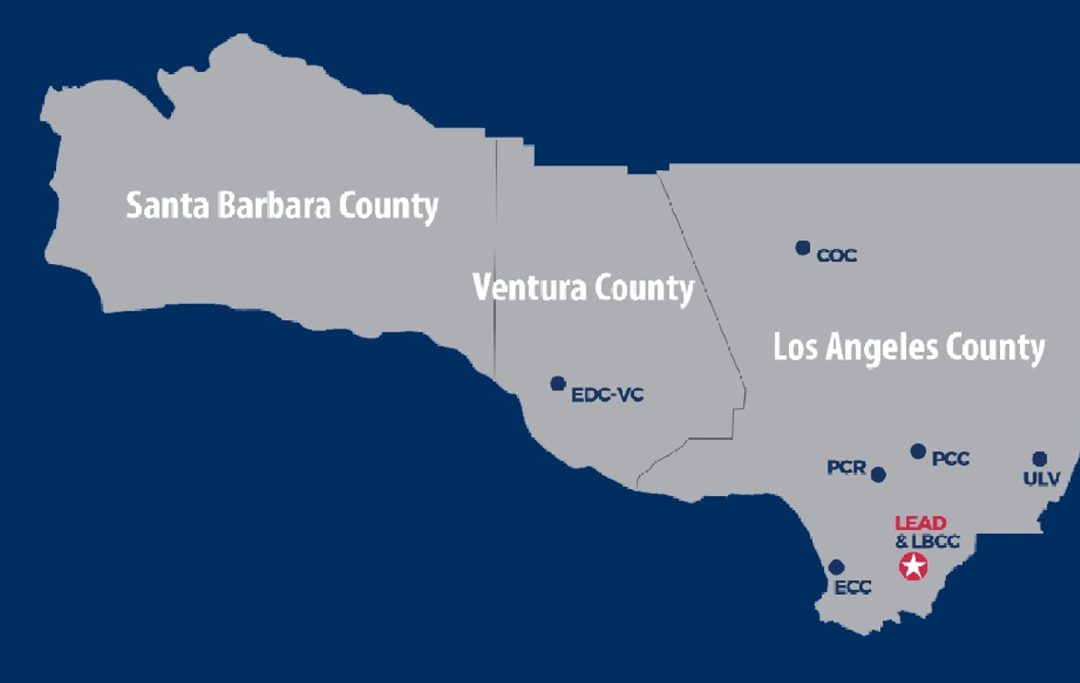
Where we are
The Los Angeles Regional SBDC Network operates seven service locations throughout Los Angeles, Santa Barbara, and Ventura Counties. Our services are also offered virtually!
LA Regional SBDC Network operates seven service locations throughout Los Angeles, Santa Barbara, and Ventura Counties.

Slide 15
What We Do
We are here to help. We empower small business owners by offering tailored solutions through personalized one-on-one business advising, cutting-edge workshops, and comprehensive programs—all provided at no cost. We are dedicated to supporting your entrepreneurial journey every step of the way.
We help businesses at every stage:
No-cost, confidential, business advising services
Training opportunities
Across Los Angeles, Santa Barbara and Ventura Counties

Slide 16
Contact us today to get started!
1-866-588-SBDC
smallbizla.org/newclient
Notes:
REMEMBER – WE’RE HERE TO HELP THROUGH ALL OF IT!
We’re here to help answer your questions; we have over 150+ consultants at the ready to help businesses just like you.
We can walk you through loan applications, your P&Ls, financial projections, and marketing and sales strategies step-by-step – all at no cost.
You can schedule a consultation through our 800# and also through our website.

