Slide 1
Insert Presentation Title Here
For Small Businesses

Slide 2
Insert Presentation Title Here
For Small Businesses

Slide 3
Insert Presentation Title Here
For Small Businesses

Slide 4
Insert Presentation Title Here
For Small Businesses

Slide 5

Your Name
Insert Photo Here
Business Advisor
xxx-xxx-xxxx
xxxxxxxxxxxxxx@smallbizla.org
Los Angeles Regional Small Business Development Center Network

Slide 6
Who We Are
The SBDC is a national program with over
1,000 locations across the country, helping to stimulate economic growth through business advising and development.
We offer no-cost services to the local businesses through funding provided by the U.S. Small Business Administration (SBA), and from the Office of the Governor on Business & Economic Development.

Slide 7
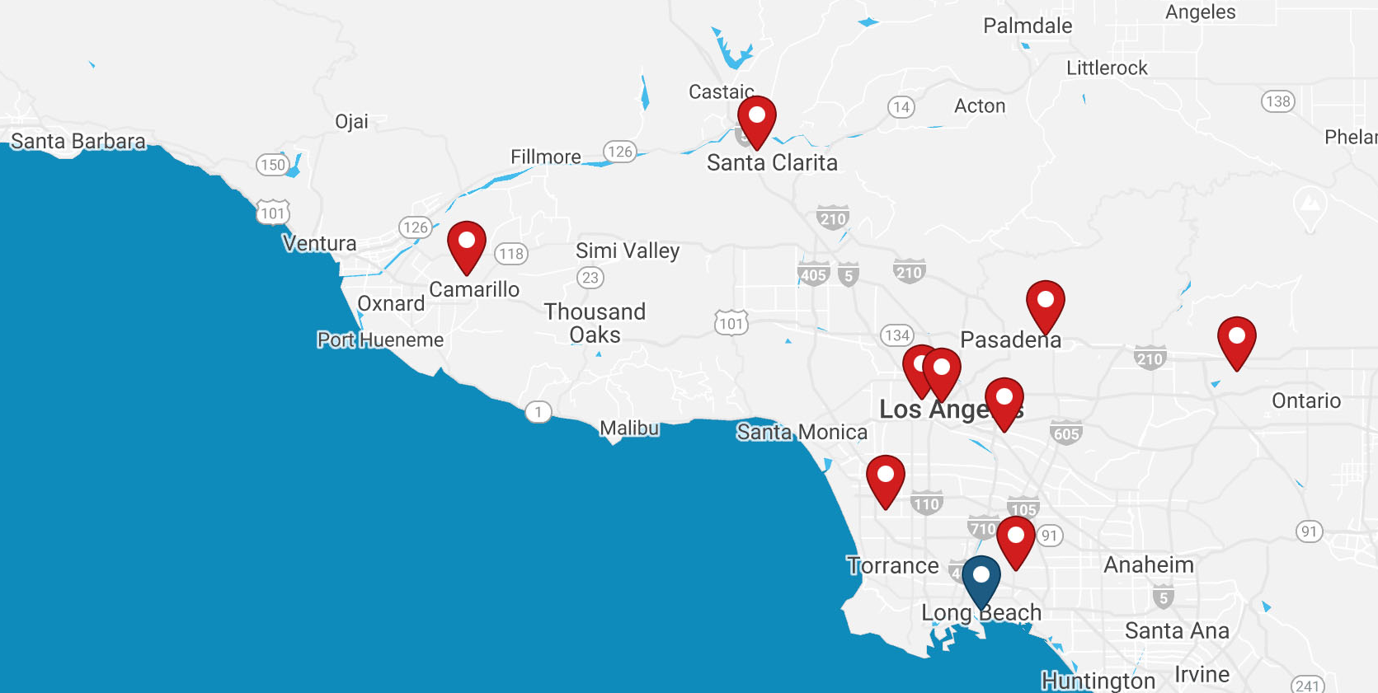
Where We Are
LA Regional SBDC Network operates ten service locations throughout Los Angeles, Santa Barbara, and Ventura Counties.

Slide 8

What We Do
We are here to help.
From assistance in accessing emergency capital to planning for the new business landscape, our SBDC business experts are standing by to support you with no-cost advising and training.
Our small business experts can help you with:
  Re-Opening Strategies
  Advising on Disaster Funding
  Adapting Post-Pandemic

Slide 9
Services Offered
At the SBDC, we offer no-cost advising on navigating current economic challenges, online training opportunities, and strategies to help you safely re-open your business.
No-Cost
Business Advising
Meet one-on-one to address your specific needs and challenges
Virtual Training
Comprehensive workshops to help adapt and grow your business

Slide 10

Contact us today
to get started!
1-866-588-SBDC
smallbizla.org/newclient
We Are
Here To Help
Notes:
We’re funded by the SBA and receive our information directly from the SBA so you can rest assured it’s accurate.
We’re here to help answer your questions, we have 100+ consultants at the ready helping businesses just like you.
WE can walk you through loan applications, your P&L’s, financial projections, marketing and sales strategies step-by—step – all at no cost.
You can schedule a consultation through our 800# and also through our website.

